Slide 1
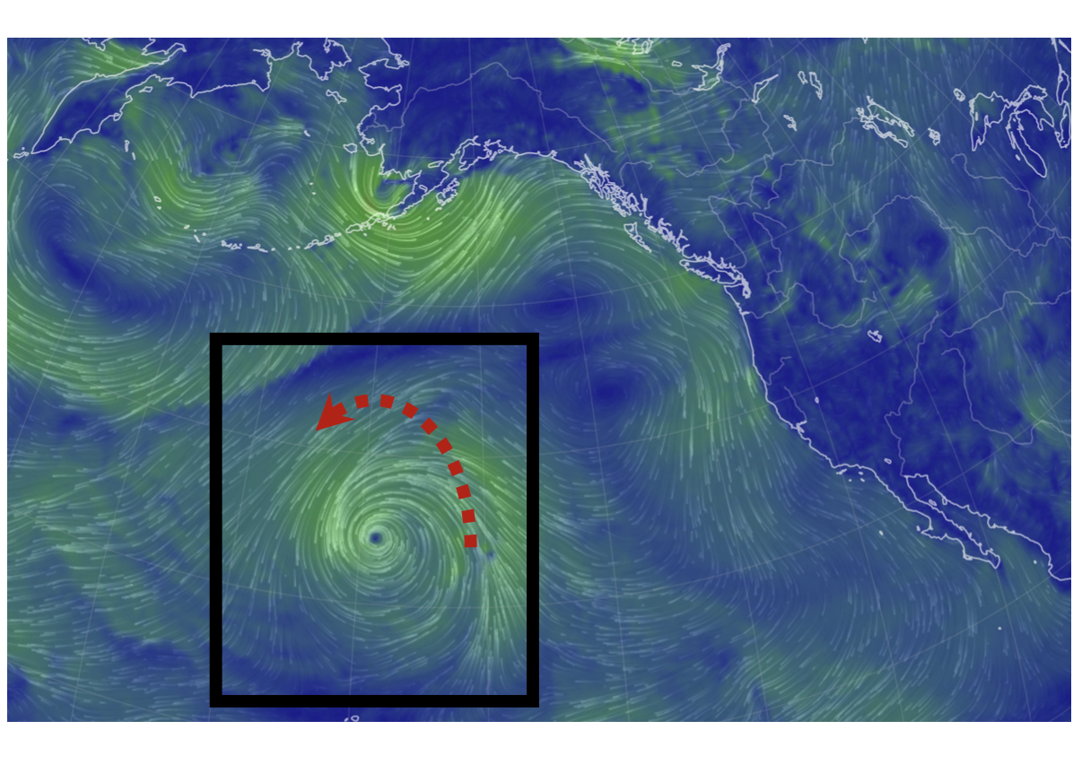
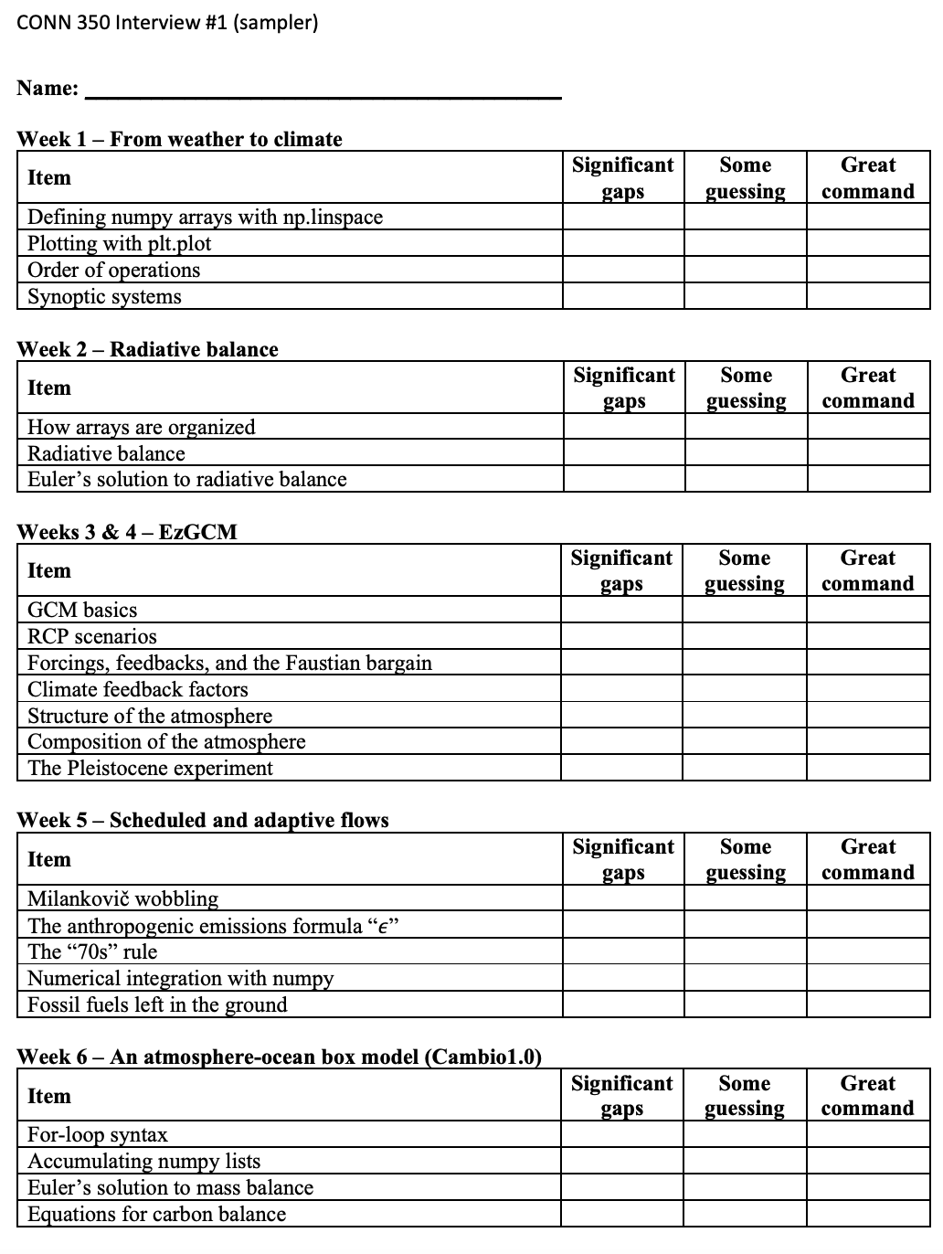
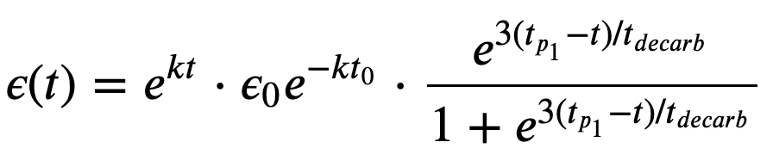
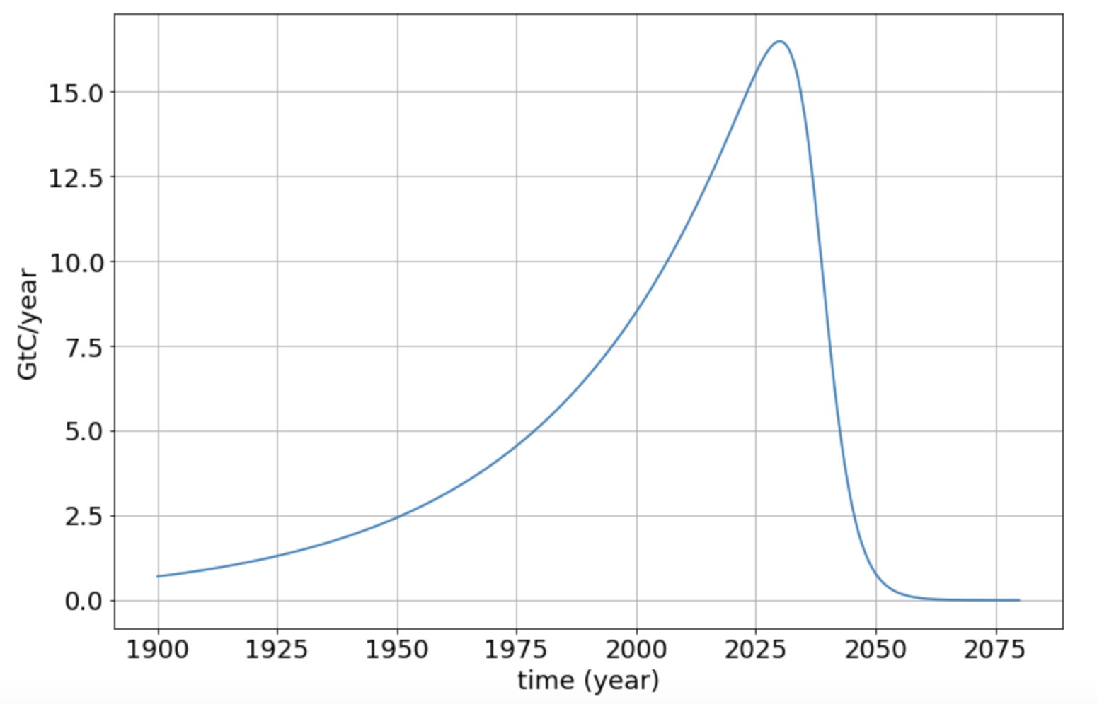
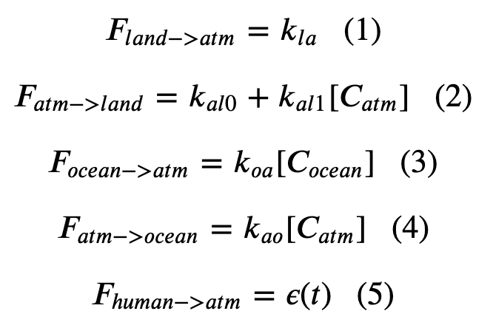
What we’ll be doing during the interview
ASR
OLR
…

Slide 2
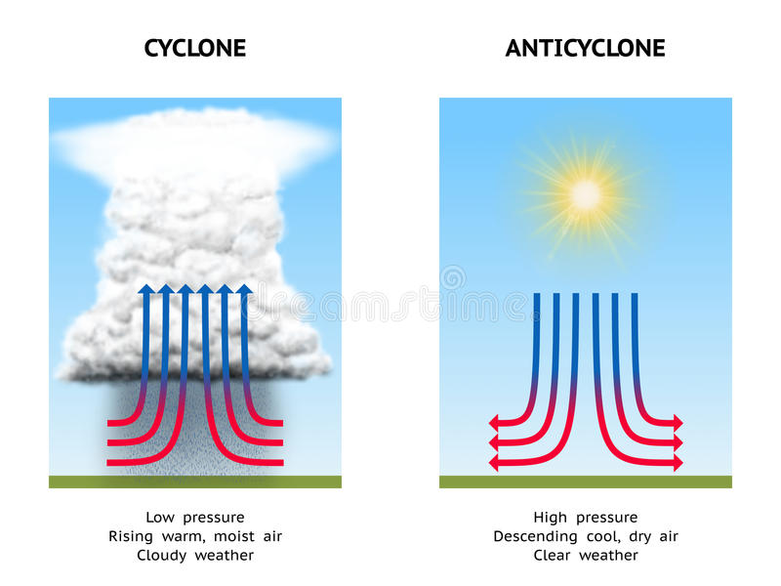
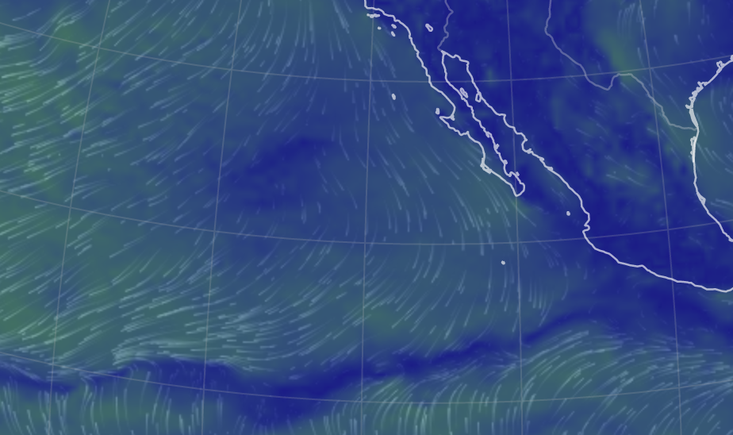
How to prepare: For our canned models, review them, and check out PPT slides about them
Earth.nullschool.net
Is it stormy and rainy here, or clear and dry?
Is this a low-pressure system or a high-pressure system?

Slide 3
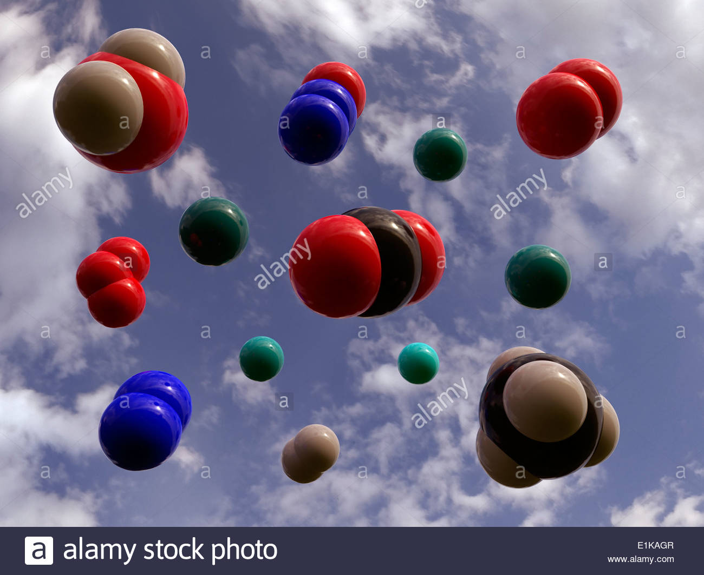
Check out PPT slides that had some interactive thing we did in class
Secondary:
Water vapor (H₂O)
Argon (Ar)
Trace amounts:
Carbon dioxide (CO₂)
Nitrous oxide (N₂O)
Methane (CH₄)
Ozone (O₃)

Slide 4
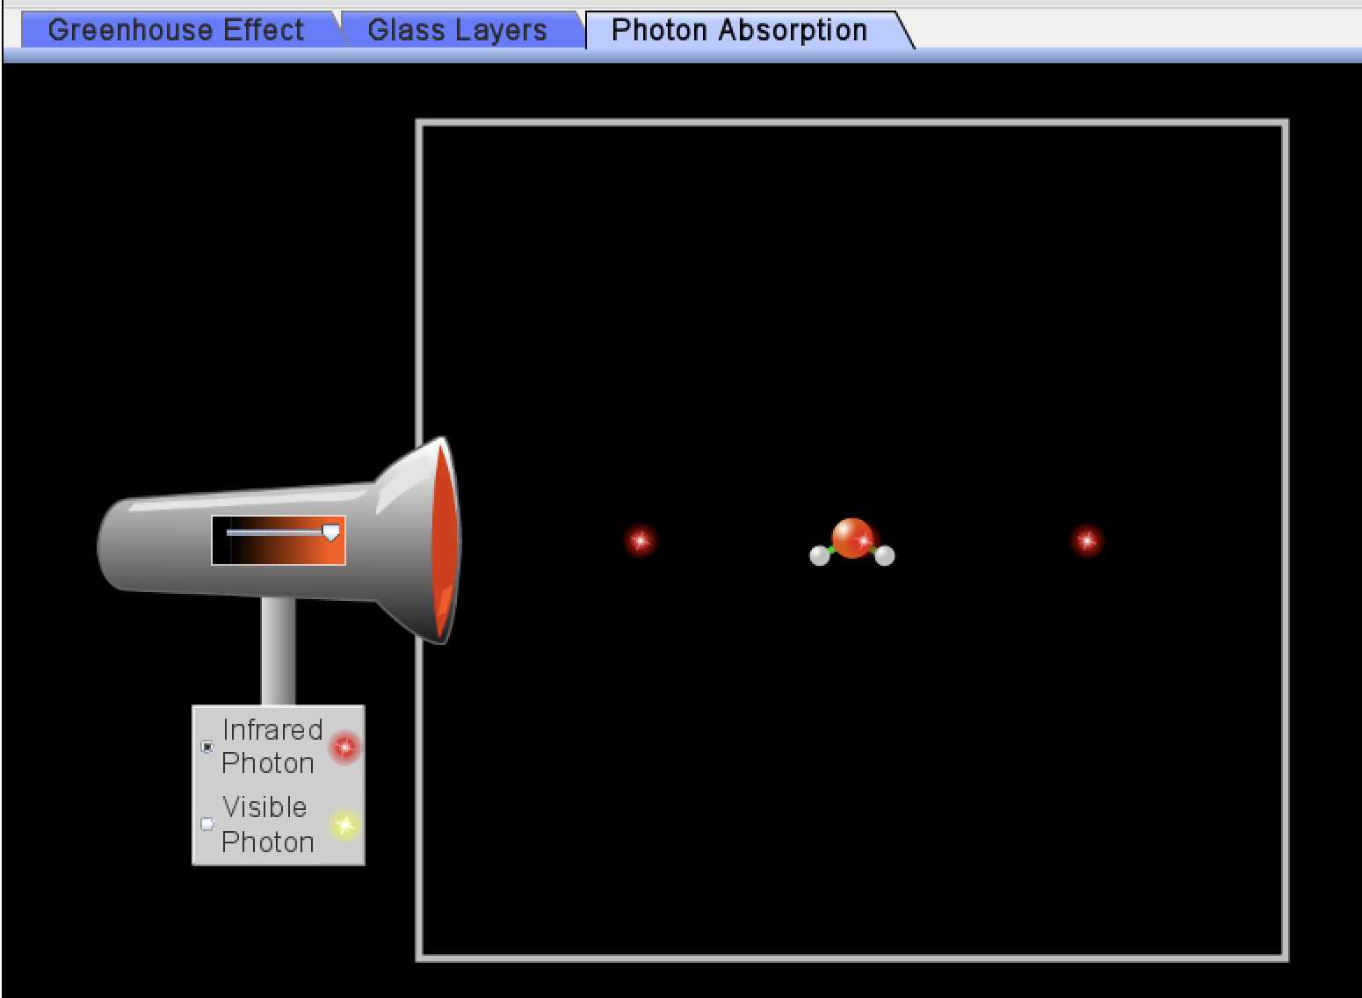
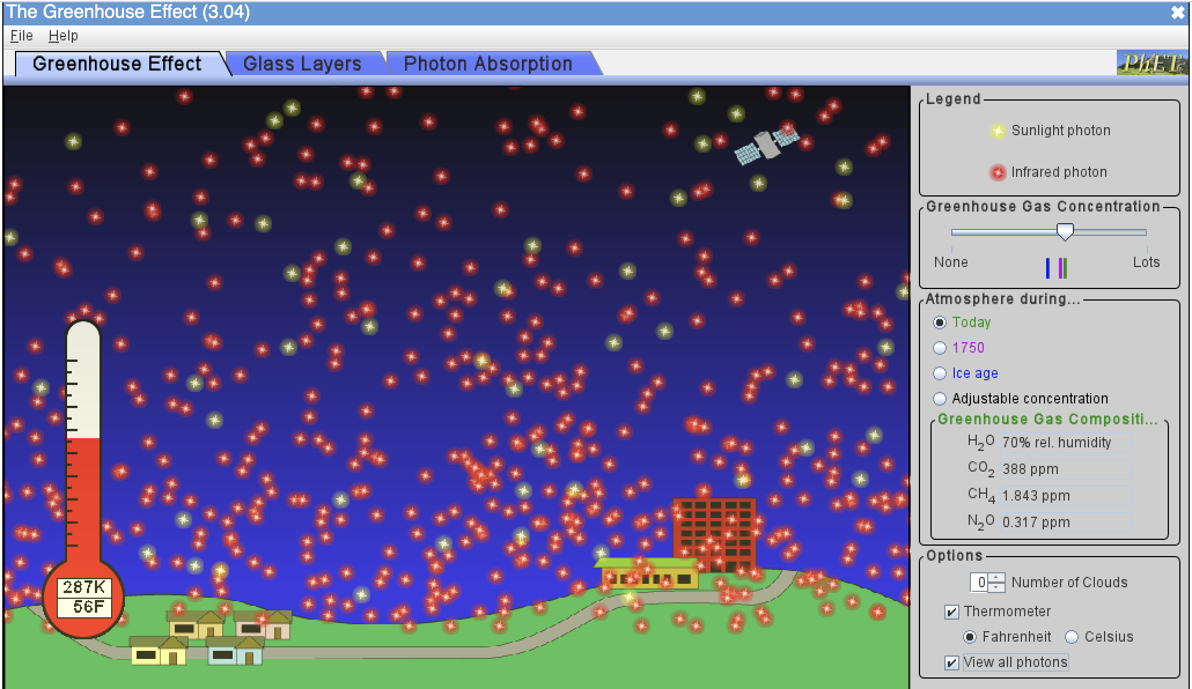
Also check out the “Let’s get started” PPT slides that have questions on them
What kind of light (SW or LW) do GHG molecules absorb?
What happens to those molecules when they absorb that light?
Assuming radiative balance, why are there more LW photons leaving Earth than SW photons coming in?
What seems to be the homeostatic temperature (in degrees K, C, F) with default settings?
How much colder was it back in 1750 compared to now?
How much colder was it during ice ages compared to now?
What effect do clouds have on SW photons?
On LW photons?
On temperature?
https://phet.colorado.edu/sims/cheerpj/greenhouse/latest/greenhouse.html?simulation=greenhouse

Slide 5
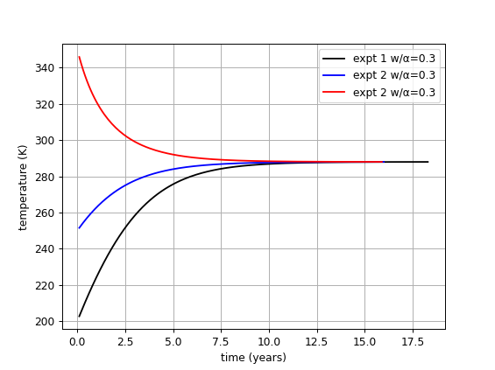
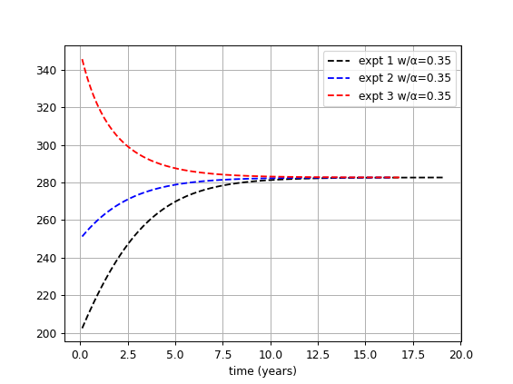
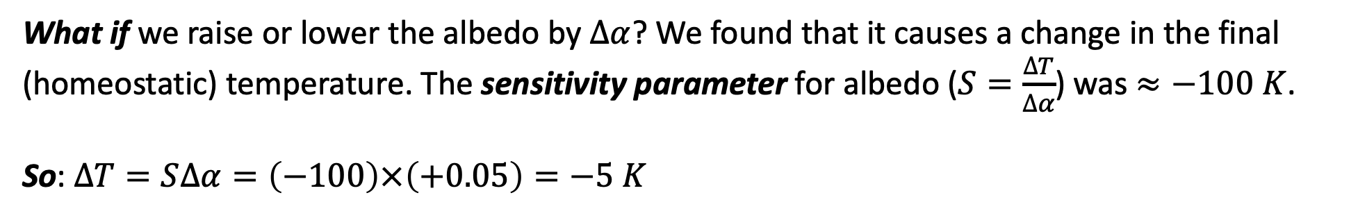
Often, what you did in Python has some take-home messages
What-if?
What if we raise or lower the albedo by $∆α$? We found that it causes a change in the final (homeostatic) temperature. The sensitivity parameter for albedo ($S=\frac{∆T}{∆α}$) was $≈−100 K$.
So: $∆T=S∆α=\left(−100\right)×\left(+0.05\right)=−5 K$

Slide 6
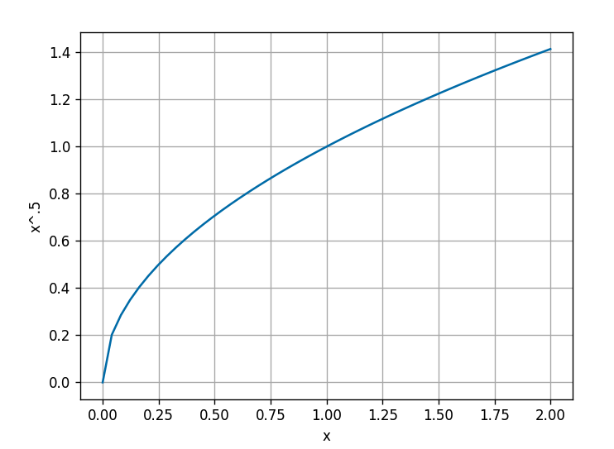
Don’t forget to pay attention to basic Python syntax (especially if you’ve done it a lot)
If we say this:
xarray = np.linspace(0,2,100)
rootx = xarray**(1/2)
Then, which of the following will produce the graph shown at right?
plt.plot(xarray,rootx)
or
plt.plot(rootx, xarray)

Slide 7
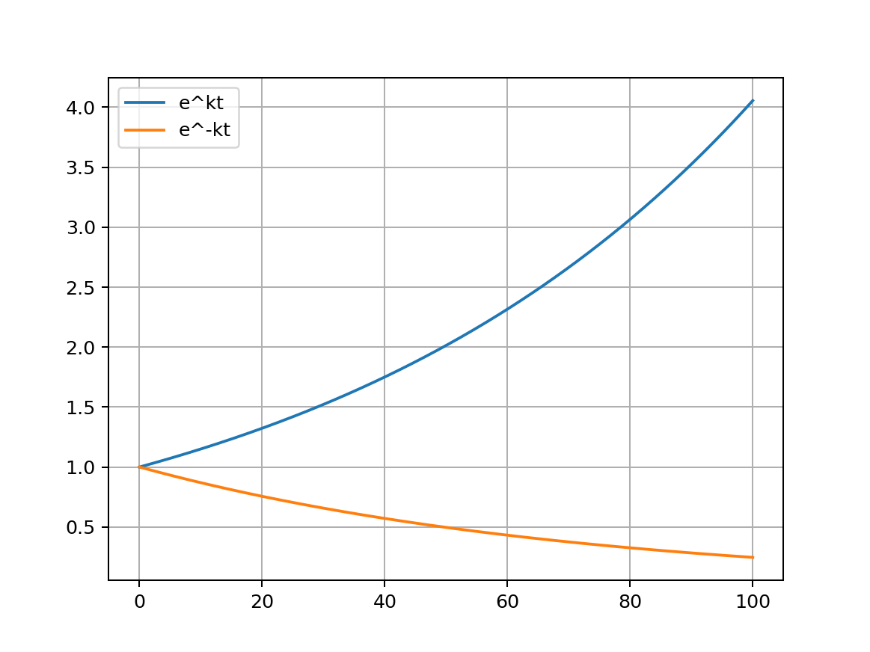
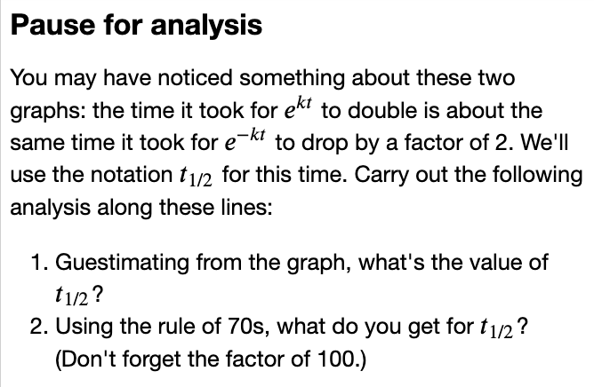
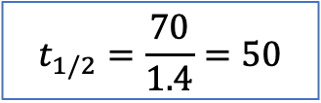

Also, take note of questions asked in Pause for Analysis
$$k = 0.014$$
$$t_{1/2}=\frac{70}{1.4}=50$$

Slide 8
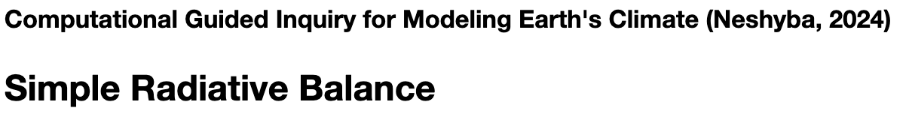
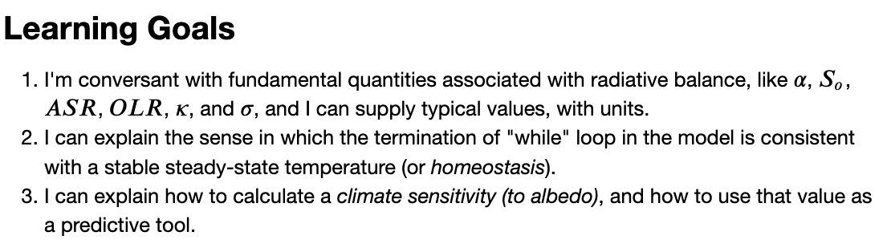
“Let’s get started” slides often have learning goals

Slide 9
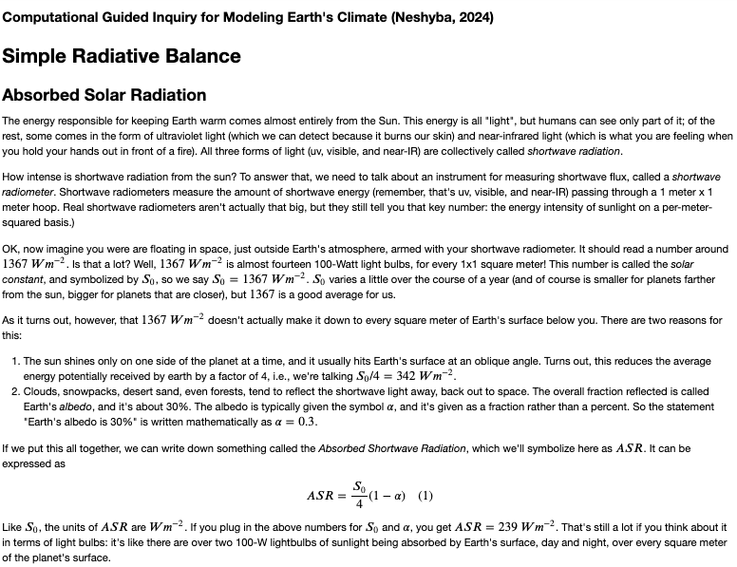
And the Python notebook Introductions serve as a kind of text for more depth

